Slide 1

Machine Learning
Course project title:- Fake news prediction
Presented by Ruth Tamiru
Feburary 2024

Slide 2
Objective of the project
To develop a machine learning model that can accurately predict fake news with an accuracy of at least 80%, using a balanced dataset of real and fake news articles.

Slide 3
Tools and libraries
Logistic Regression: A simple yet effective linear classification algorithm that can be used to predict the probability of a news article being fake or real based on a set of features.
Scikit-learn: A popular Python library for machine learning that provides implementations of many of the algorithms mentioned above.
NLTK: A Python library for natural language processing (NLP) tasks, which are essential for preprocessing and analyzing text data for machine learning models.
SpaCy: Another popular NLP library with a focus on industrial-strength applications.

Slide 4
Data source and preprocessing techniques
Fake news or hoax news is false or misleading information presented as news. Fake news often has the aim of damaging the reputation of a person or entity, or making money through advertising revenue.
The dataset I used is taken from kaggle dataset(fake news prediction dataset) having Both Fake and Real news.
The columns present in the dataset are:-
1) Title -> Title of the News
2) Text -> Text or Content of the News
3) Label -> Labelling the news as Fake or Real

Slide 5
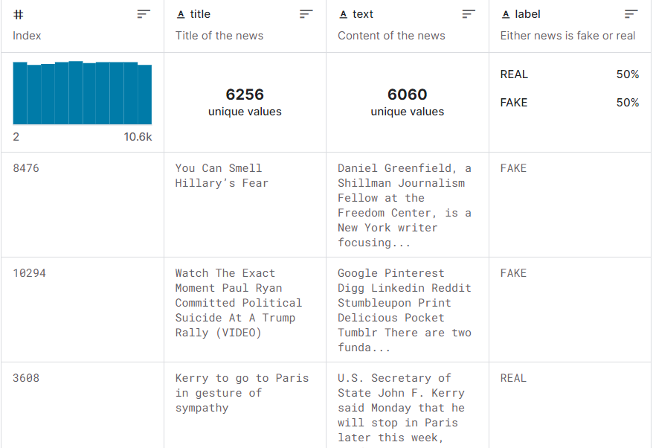

Slide 6
Pre-processing techniques used
Process the text into vector (the vector size is 300)this is done by using the word vectors from a large SpaCy model for text embedding
The column title and text (textVector will be used instead) will not use in this analysis
Split the dataset into training and test datasets

Slide 7
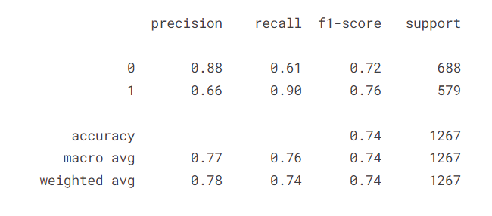
Result analysis and conclusion

